Slide 1

Principles of Good Bot Design
Speaker name
Notes:
This session is brought to you by the AI Engineering team.

Slide 2
Session objectives and takeaways
At the end of this session, you should be better able to…
Conduct effective design research.
Understand technology capability
Map Bot capabilities to organizational objectives.
Notes:
This session focuses on the design aspects of bots with an emphasis on good bot design that has been established by conducting engagements with partners and customers. At the end of this session you will be able to:
Conduct effective design research
Understand technology capability
Map Bot capabilities to organizational objectives

Slide 3
Effective Design Research
Notes:
In this section, you will explore the steps required to conduct effective design research, including:
Understanding the organizational requirements.
Understanding the types of conversation patterns.
Building a personality profile for you bot.

Slide 4
Understanding the Organizations Requirements
Defining Objectives
Corporate Objectives
Transformation Objectives
Project Objectives
Objectives must meet:
Desirability Criteria
Feasability Criteria
Viability Criteria
Establish Use Case/Scenario
Map out the Lifecycle/Workflow
Extrapolate high level domains/intents
Notes:
During the design phase, it is typical to perform a discovery workshop on the requirements for implementing a bot for the organization. The purpose of the workshop is to establish the problem/use case that the bot is going to solve, assess the desirability, feasibility and viability criteria, and ensure that the specific use cases/bot conversational flows and intents are appropriately captured.
Desirability = includes the human factors (is there a human need for this innovation? Or are we making this bot for the sake of making a bot?)
Feasibility = technically feasible (is the technology available to actually do this?)
Viability = financially viable (is this sustainable from a business perspective)
Bots and Conversation as a Platform in general is a major technology shift and is considered a megatrend in the digital transformation space. Setting appropriate expectations, project goals and design guidelines are essential in ensuring that customers that embark on a conversation as a platform initiative drive the best value from their investment, and in-turn continue to build and grow their conversation platform initiative, driving future growth and continued end-user adoption.
It is important to dedicate the right amount of focus on design and not get deep into Bot Architecture, Toolkits and other tech-led conversations. This is not just a technology, it facilitates interaction, a human-to-computer interaction. It’s an experience! which is why we have UX and Architect leading the design conversations with other business stakeholders, including:
Project Sponsor and other business leaders that can speak to the desired outcome from the engagement and conditions of satisfaction
Business Domain experts specific to the scenario and use cases being explored with Bot.
Subject Matter experts that can speak to the knowledge domain and are familiar with the conversations we expert bots to have with end-users
Technical leads that understand the overall Systems Architecture of knowledge sources and can cover any aspect of backend knowledge/integration possibilities
Core Project team members, including Project Managers and Technical Consultants to ensure they are aligned with overall design requirements and business expectations.
The following are some general guidelines on running a workshop. These are harnessed through previous engagements conducted by the teams.
Start the discussion broadly with Design Led Thinking making sure Desirability, Feasibility and Viability criteria are top of mind.
Use existing logs/fact based analysis for driving towards top intents and key uses cases.
Use the Pareto Principle to make the cases if applicable
In a complete green-field scenario start by defining the personas and then use the lifecycle of the personas to identifying specific use-cases
Gauge the level of understanding around Bot terminologies in the audience and feel free to set the stage with key terms and taxonomies, this allows the audience to stay engaged during the workshop and not get lost in taxonomies.

Slide 5
Conversation patterns
One-Turn FAQ
One-Turn Intelligent Response
Intelligent Notification
Multi-Turn Process Guidance
Contextual Guided Assistance
Multi-Turn Conversational Task Completion
Increasing complexity
Notes:
While working on defining use cases, there is a varying level of complexity involved with certain types of conversational flows. For example, a one-turn dialog that is simply responding by pairing an answer to a question (or set of questions) is a low complexity use case. A multi-turn dialog that needs to extract multiple entities, has to remain context sensitive and is doing some type of task completion which also requires backend integration is a high complexity use case. Then there are other patterns that fall somewhere in between these two extremes. To manage priorities across use cases and overall acceptance criteria for the project, within the constraints of the project scope, it is important to bring in a complexity discussion while walking through the use cases.
One way to manage these conversations is by defining a set of conversational patterns that are organized by the level of complexity where each use case, as it is discovered, is mapped to one of those conversational patterns. These can be organized as follow:
One-Turn FAQ These are general FAQ style answers that is based on one-turn responses.
Intelligent Notification This is a notification pattern because it is not in response to any query initiated by the user. Design guidance suggests caution when it comes to the bot providing proactive notification.
One-Turn Intelligent Response These are also one-turn responses which don’t typically have a follow-up or additional conversational flow. These are “intelligent” terms as they need to be provided within the context of a conversation or activity. For example, a customer may ask, what time does flight XX065 leave LAX today?
Contextual Guided Assistance In this scenario, context is associated with the page/url the user is on as opposed to who the user is and would like the bot to be able to answer questions within this context of the page/url.
Multi-Turn Process Guidance This is a unique scenario within the users domain - there are a number of process flows established that a bot can be enabled to do a user walk-through. While these are multi-turn dialog scenarios, they are not truly conversational as the user responses are restricted to Yes/No only with potentially an option to opt out or cancel the guided assistance.
Multi-Turn Conversational Task Completion This is a multi-turn conversational pattern typically leading to a task completion scenario. In this type of pattern, the user is not restricted to fixed responses and can potentially provide free-form natural language response. The bot will need to interpret this within the context of the process the user is in.

Slide 6

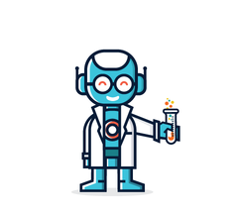



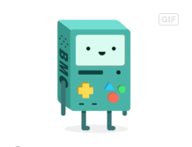
CHATBOT Personality Profile – It represents your brand after all.
AGE
OCCUPATION
RESIDENCE
USER-LEVEL
35
Associate Agent
Manchester
lower-mid (~4 years)
GOALS
Assist attendees with booking onto a conference
Answer conference related Q&A
Assist customers with finding video and slide resources of sessions at previous conferences
PERSONALITY
TARGET USERS
The personality profile is designed to targets the following user profiles.
Attendees of the conference
Non attendees viewing videos
Exhibiters of a conference
Extrovert
Introvert
Sensing
Intuition
BIO
BitBot has a few years of experience under his belt when it comes to working with data. As an employee he can point to the right videos and resources by reacting quickly and professionally to attendees needs and requests.
Thinking
Feeling
Judging
Perceiving
PAIN POINTS
Lack of understanding
Request complexity
Unclear expectations
CHARACTER
Experienced & Active
Helpful & Courteous
Straightforward & Urgent
Professional & Savvy
SAMPLE AVATARS
We‘ve selected four avatar themes. Based on your feedback we will develop your selection into an icon representing Freddie.
Replace with Customer Logo
Notes:
Would you trust someone not in your organization to speak on behalf of your organization?
Your bot is going to be the spokesperson for your company. That’s why it is important to have a mix of business stakeholders ranging from UX leads, project owners and other stakeholders in the design phase of the bot. Most customers are looking at either knowledge orientated or task completion bots, and expect bots to be able to answer general knowledge questions, integrating that is not a big deal if you use knowledge search. What is often overlooked is the personality of the bot. Personality makes a difference, even if its in subtle ways. Remember that it will be representing your brand and as such it is important to consider the personality profile so that it represents your company at its’ best.
Options to consider when defining a bot personality profile include:
Demographics
BIO
Goals of the bot
Pain Points of the bot
Personality
Character
Target users

Slide 7
Discussion – Bottlenecks to Effective Design Research
Here is a more detailed view of the Top Business Intents as LUIS intents.
What factors could affect effective design research?
How would you overcome such factors?
Bot personality profiling may be viewed as non serious. How would
you address this mindset?
Notes:
The following are potential answers to the questions, but encourage your students to come up with more.
What factors could affect effective design research?
There are a range of answers here that could impact the effective design research including the following:
Project lacks diversity and depth for a full design review.
Time limitations leading to an incomplete or partial research.
A lack of understanding of the corporate, transformation or project requirements
Lack of support from senior stakeholders
How would you overcome such factors?
Project lacks diversity and depth for a full design review.
Consider seeking buy in from senior stakeholders to allow a variety of people with different backgrounds to take part in the review. PR and marketing professionals can be very helpful, as well as technologist and Project Managers. Consider what the actions are of the bot and seek an understanding of the role. For example a concierge service for a hotel, and include people from that role.
Time limitations leading to an incomplete or partial research.
It’s important to set the correct expectations for how long effective design research will take. It is not uncommon for a number of meetings to take place as research activities are delegated to members of the team to research and report back. However, having a deadline is also important for setting a line in the sand. Without this control the research phase could go on and on
A lack of understanding of the corporate, transformation or project requirements
It is important that there is a clear understanding of the corporate, transformation or project requirements. This acts as the north star for the project and should include measures for success. This should be the first aspect of the effective design research phase that should be completed and is of the highest priority. If there is still uncertainty with goals, revisit them and investigate.
Lack of support from senior stakeholders
This is perhaps the most difficult to solve should the stakeholders in question not see any benefits to the solution and seriously impacts the desirability criteria. If this is the case it may be more pragmatic to shelve the project until there is more desire. However, before giving up makes sure that the senior stakeholders in question understand the commercial benefits of taking on the project. Be it to reduce operational costs, improve customer service and therefore retaining more new customers or using the bot for upsell opportunities.
Bot personality profiling may be viewed as non serious. How would you address this mindset?
As a technologist or Project Manager, you wouldn’t. You would lean on the expertise of the PR and marketing team to communicate the importance of the bot representing the company and how it would come across. This enables their expertise to come to the fore and cement the reason for their presence on the team

Slide 8
Understand Technology Capability
Notes:
In this section, you will understand conversation flow, including:
Microsoft Bot Framework Capabilities
Supporting technologies

Slide 9
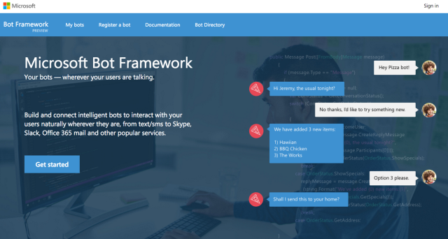
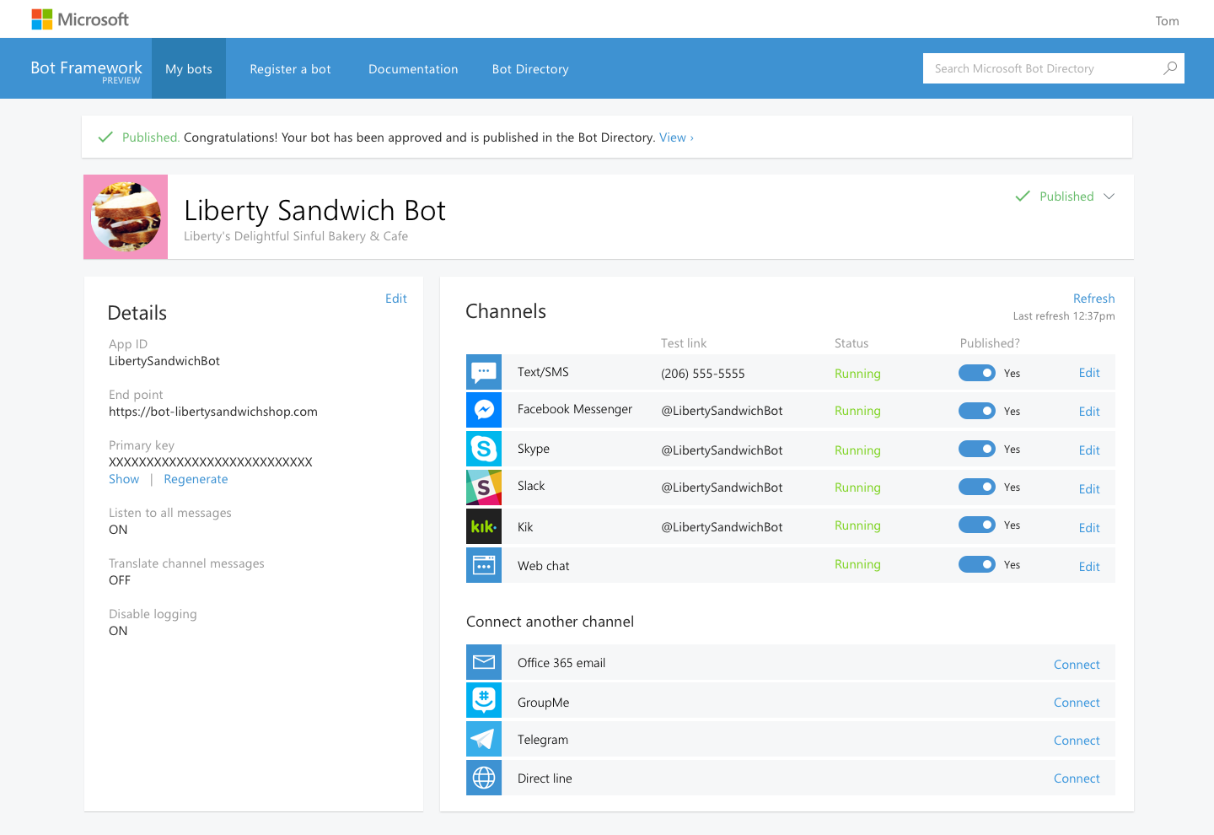
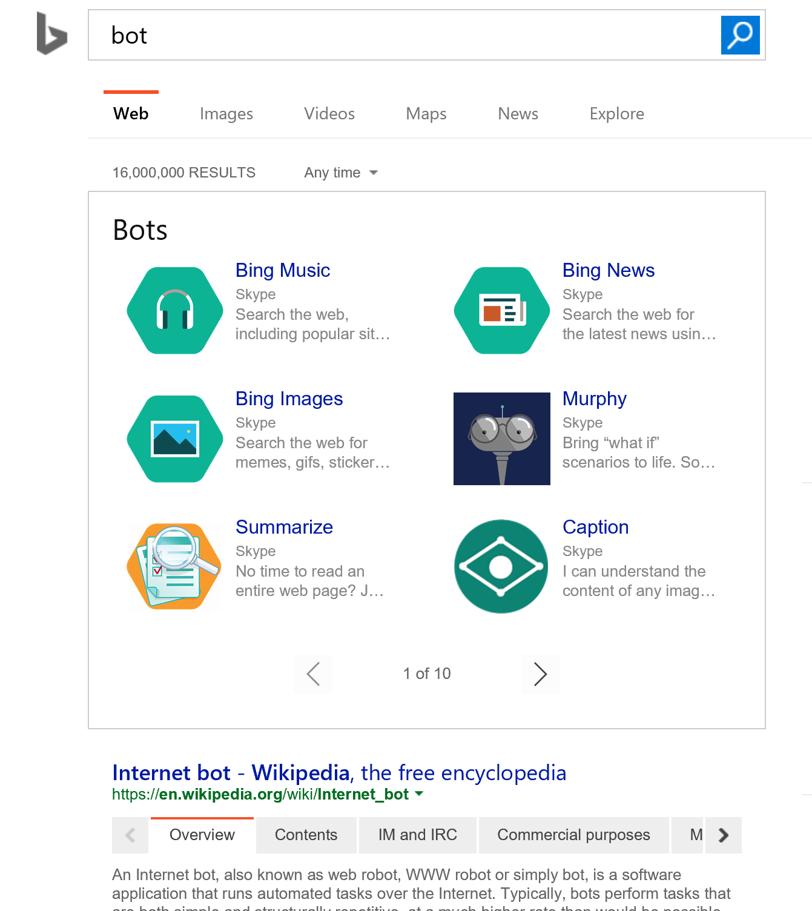
Microsoft Bot Framework Capabilities
Build once and publish your bots to the broadest set of channels your users are using
Bot Developer SDKs | Bot Channels | Bot Directory
Open source SDKs make it possible to bring your bot to life in minutes | Connect your bot to any or all of the top conversational experiences to reach >1B users | Make your bot discoverable via Bing, Cortana and other Microsoft surfaces
Notes:
The Microsoft bot framework is the #1 bot framework in the market today. This framework provides 3 key capabilities for developers. This open source framework allows developers to build bots in the languages they know and love - .Net C# and node.js The framework provides connectors to over 15 different channels. This allows developers to build a bot once, and connect it to SMS, Email, Facebook, skype, slack, kik, web chat, etc. Finally the framework allows you to publish bots to be discovered via search, Cortana and other web services. It is important to establish the skillsets of those who work at the company. From this perspective it can be established if the bot solution can be developed in-house, or establish the level of support that is required for the project to succeed. Furthermore, understanding the differences between each channel that will be used for the bot

Slide 10
Supporting Technologies
QnA Maker
Useful in the One-Turn FAQ responses and/or Contextual Guided Assistance approach.
LUIS
Typically used in Multi-Turn Conversational Task Completion approach to interpret the free flow text.
Can be used to aid the One-Turn Intelligent response scenario.
FormFlow
Useful with Multi-Turn Process Guidance and Intelligent Notification.
Cognitive Services
Machine Learning
A range of services that can be used to complement all conversation flows.
Notes:
There are a range of supporting technologies that can be integrated into the bot framework to enhance and optimize the conversational flow. Understanding the capabilities of each technology is important as it can help you map a technology to a conversation pattern. The slide shows the mappings that can be used for conversational flow and technology.
QnA Maker - https://www.qnamaker.ai/
FormFlow - https://docs.microsoft.com/en-us/azure/bot-service/dotnet/bot-builder-dotnet-formflow
LUIS - https://www.luis.ai/
Machine Learning - https://docs.microsoft.com/en-us/azure/machine-learning/
Cognitive Services - https://azure.microsoft.com/en-gb/services/cognitive-services/

Slide 11
Mapping Bot Capability to Organization Objectives
Notes:
In this section, you will explore examples of mapping Bot capability to organizational objectives, including:
High Level Bot Logic Flow
Bot Evolution Roadmap

Slide 12
BOT LOGIC FLOW – High Level
Here is a high level logic flow for the bot starting with Top Intents.
Business Domain
Conference Management Bot
Get video
Top Business Intents
Booking Information
Agenda Information
Exhibitor Information
General Q&A
Get video
Multi-Turn Process Guidance Dialogs
Conversation Patterns
Multi-Turn Conversational Task Completion
One-Turn Intelligent Response
Dialogs
One-Turn FAQ
Get video
Additional Requirements
Personalized Greetings
NOTE:
This output is not set in stone and provides a high level deliverable to drive the conversation
Notes:
The slide shows an example of how you can map the domain and use case intents at a high level. Remember that the intention here is not to focus on the technology, but more on the business domain, intents and potential conversational flow. In addition you can annotate the diagram to outline any additional requirements such a personalization. The High Level Bot Logic Flow does not have to use this format, but it is important to ensure that the format is understood by the intended audience. Furthermore, this document is not fixed and the expectation should be set with the customer that the initial findings could change with further investigation.

Slide 13
BOT EVOLUTION/ROADMAP
The following illustrates use cases selected for the Project (highlighted) as well as potential future use cases that can be considered to further evolve bot experience.
Current Scope
Scope v Next
Scope v Next+1
Booking Information
Agenda Information
Exhibitor Information
General Q&A
Notes:
The development of bots will likely be an evolution, not a revolution. It may not be possible to implement the solution in one release. It is therefore pragmatic to develop a roadmap of the functionality of the solution. The slide shows an example of a roadmap.

Slide 14
Discussion – Importance of Stakeholder Sign-off
Here is a more detailed view of the Top Business Intents as LUIS intents.
How would deal with individuals who required more detail
than the High Level Bot Flow Logic would provide?
What artefacts in addition to those seen in this module
would you require to ensure sign-off?
Notes:
The following are potential answers to the questions, but encourage your students to come up with more.
How would deal with individuals who required more detail than the High Level Bot Flow Logic would provide?
Outline to those concerned that the purpose of the effective design research is to establish the high level objectives of the project, understand the personality of the bot and get an understanding of the tasks that it is trying to solve so the team can start to get an understanding of what technologies may be used. The output is to create a high level bot logic flow and a roadmap with approximately timescales in the first instance. At this stage, a discovery exercise is being performed on what could be possible and more details will be flushed out in other portions of the project such as the LUIS schema design and the physical architectures
What artefacts in addition to those seen in this module would you require to ensure sign-off?
A statement of work with signatures of senior stakeholders

Slide 15
Session objectives and takeaways
Conduct effective design research.
Understand technology capability.
Map Bot capabilities to organizational objectives.

Slide 16
Additional resources
GitHub resources: http://aka.ms/icpst
Microsoft Partner: http://aka.ms.icmpn
Notes:
Use this slide to share additional content available that attendees should know about. In this section you can call out whitepapers or websites that you and your team have created.

